Slide 1

LEVEL 1 TOOLKIT

Slide 2

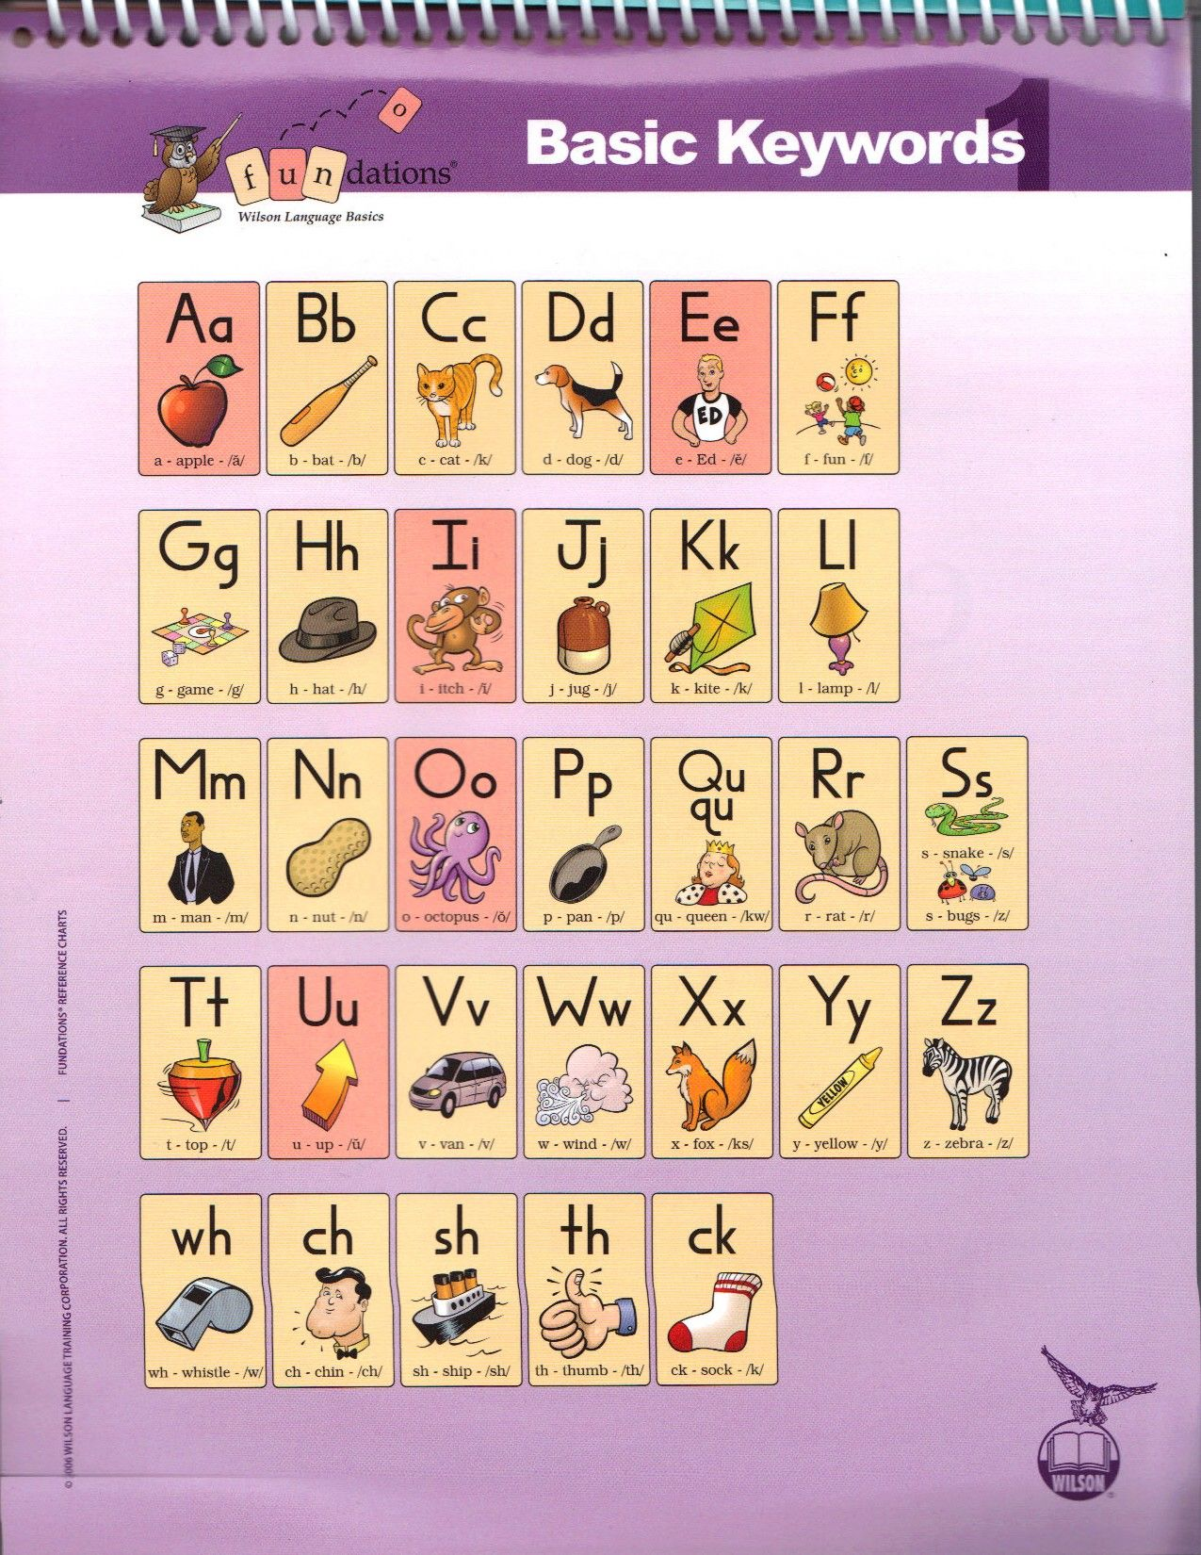
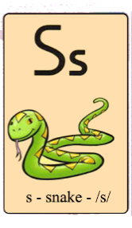
Large Sound Cards | Units 1&2

Slide 3
Large Sound Cards | Unit 3

Slide 4
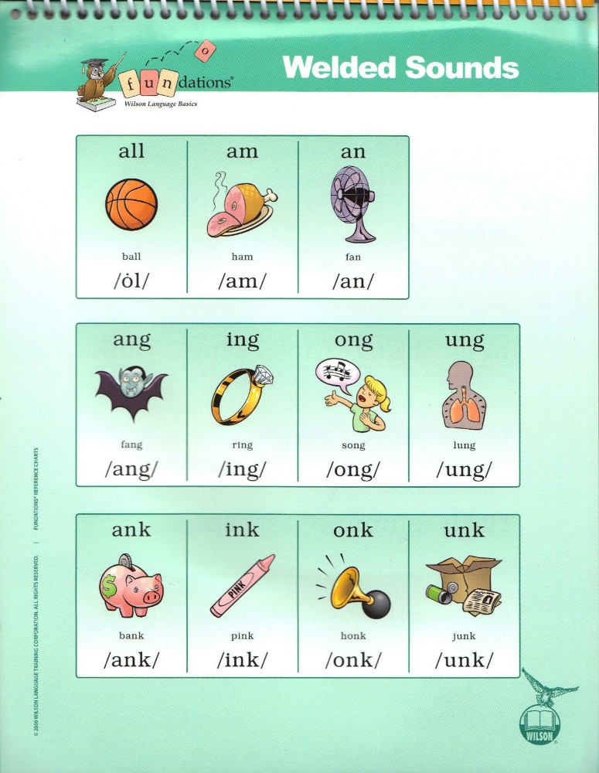
Large Sound Cards | Unit 4

Slide 5
Large Sound Cards | Unit 5

Slide 6
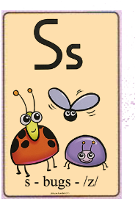
Large Sound Cards | Unit 6

Slide 7

Large Sound Cards | Units 7-14

Slide 8
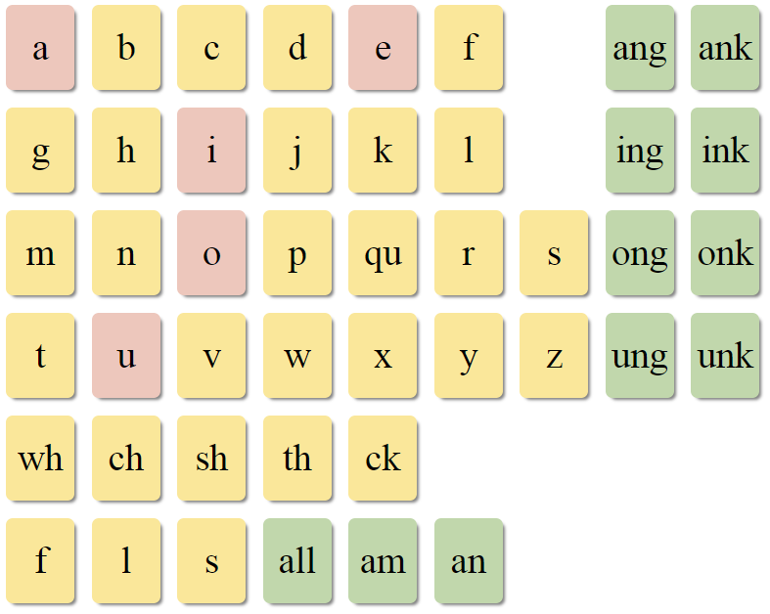
Standard Sound Cards | Units 1&2

Slide 9
Standard Sound Cards | Unit 3

Slide 10
Standard Sound Cards | Unit 4

Slide 11

Standard Sound Cards | Units 5&6

Slide 12
Standard Sound Cards | Units 7-14

Slide 13

Dry Erase Board
1
2
3

Slide 14
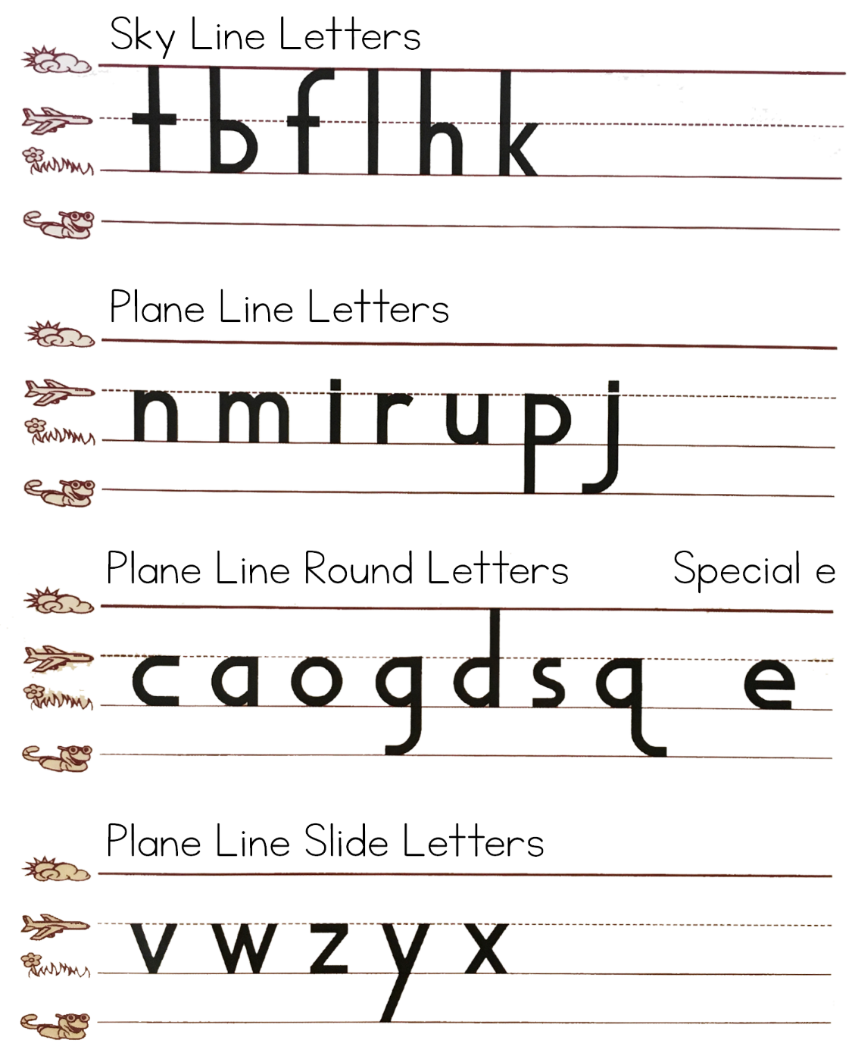
Letter Formation

Slide 15
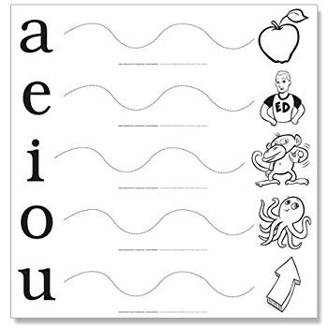
Vowel Extensions

Slide 16
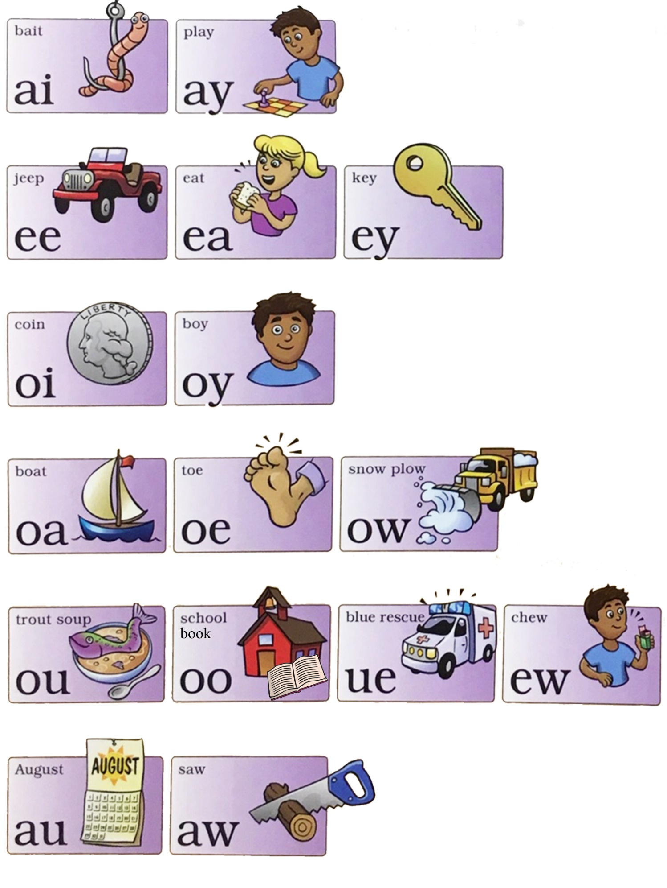
Vowel Teams

Slide 17
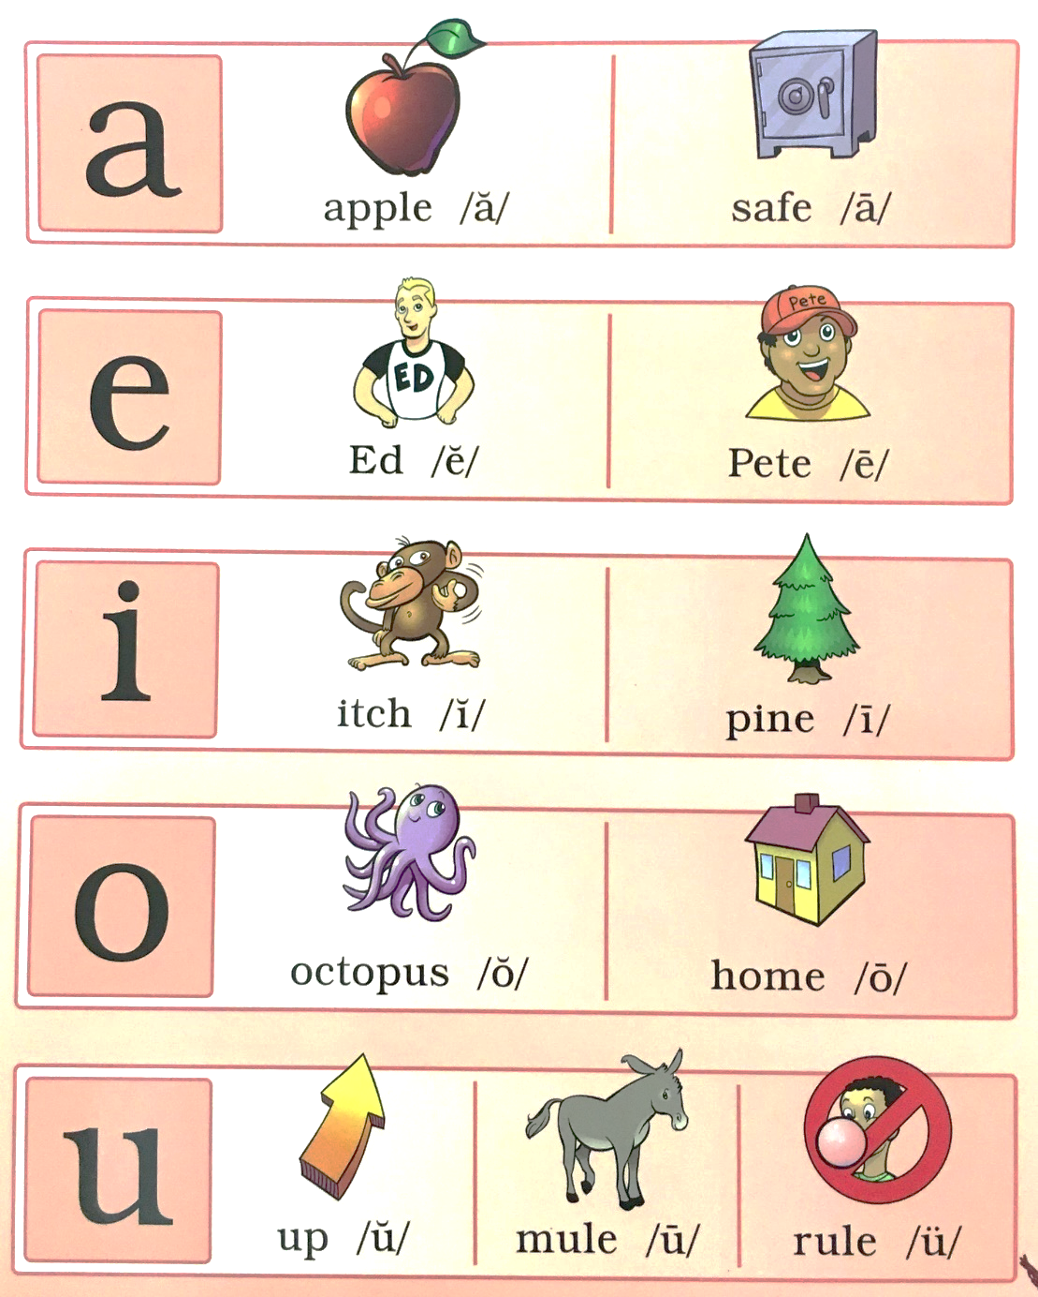
Long Vowels / Short Vowels

Slide 18
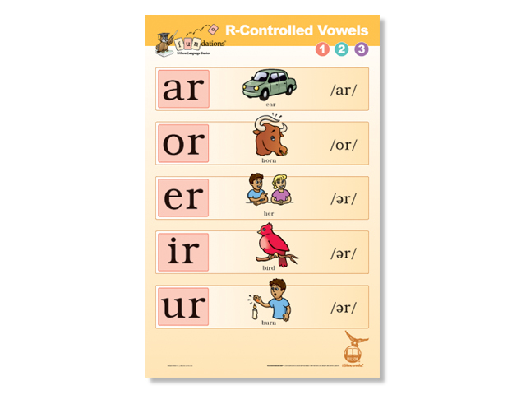
R-Controlled Vowels
car
her
bird
horn
burn

Slide 19


Teach Trick Words - Spelling
SKYWRITE

Slide 20

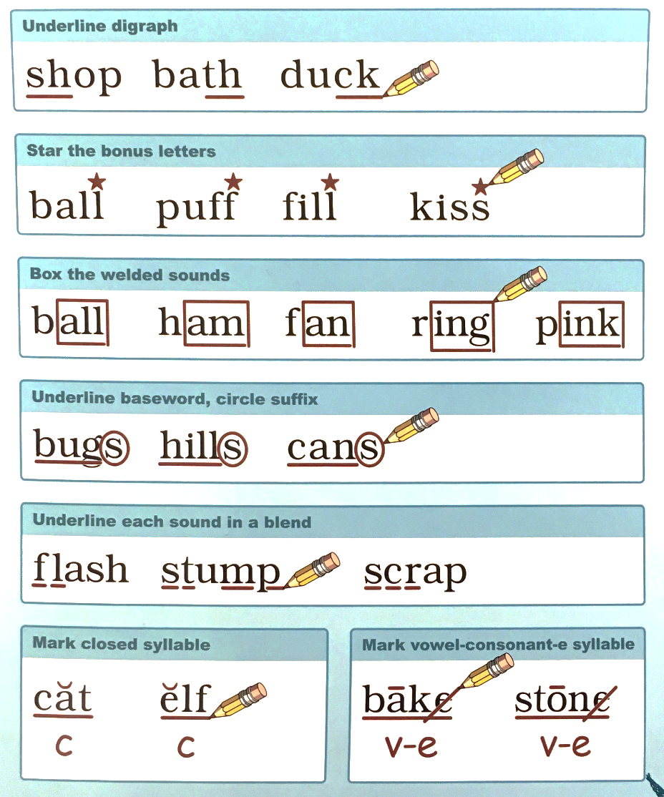
Teach Students to Mark Words
Mark my words!

Slide 21
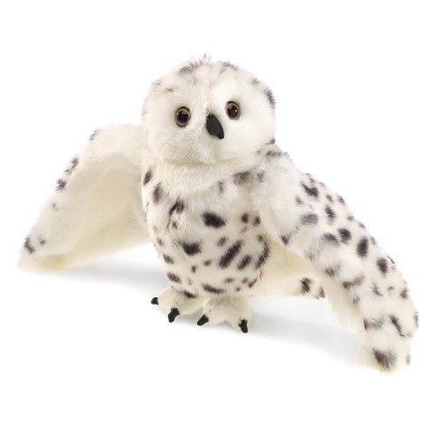
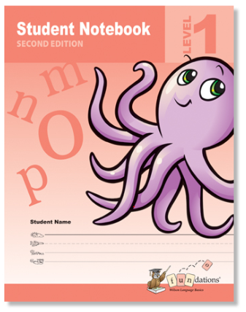
Word of the Day
Echo wants to know about the word of the day!
How do you tap it out? How many letters?
How many sounds? How many syllables? What is the vowel sound?
How can we mark it? What does it mean?
How can we use it in a sentence?
Mark the word.
Add to your VOCABULARY section.
Write a sentence with the word of the day.

Slide 22
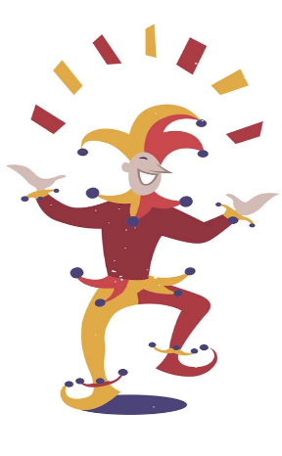
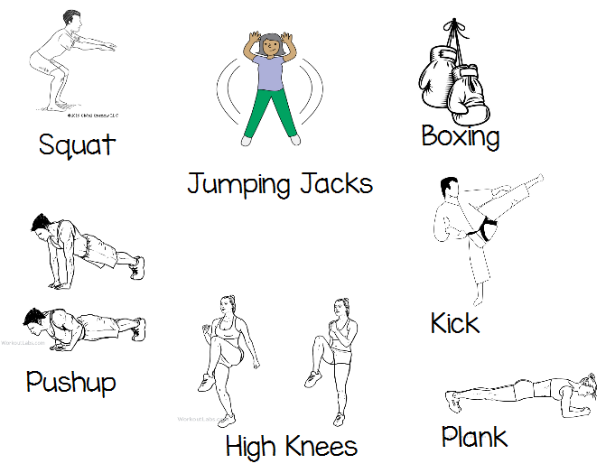
Trick Word Drills
Trick Word Boot Camp!
Pick an exercise, pick a word, then on the could of 3, everyone spells and moves!
Trick Words to Practice:

Slide 23
Teach Trick Words - Spelling
Add the trick words into your student notebook.
TRICK WORDS

Slide 24
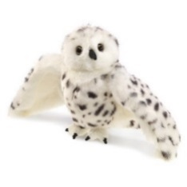
Echo / Find Letters & Words
What says….
Dictate a 3- 5 sounds then a word.

Slide 25
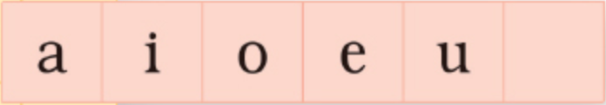
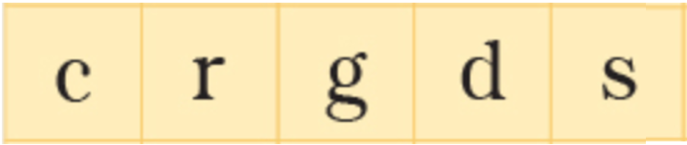
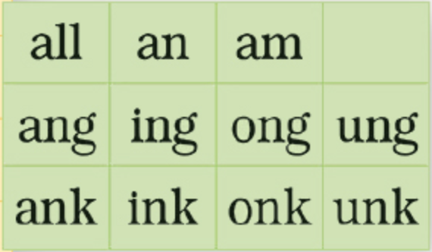
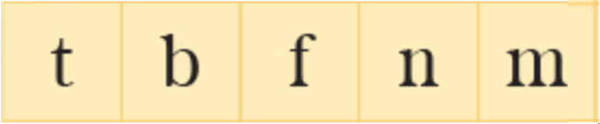
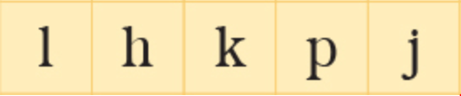
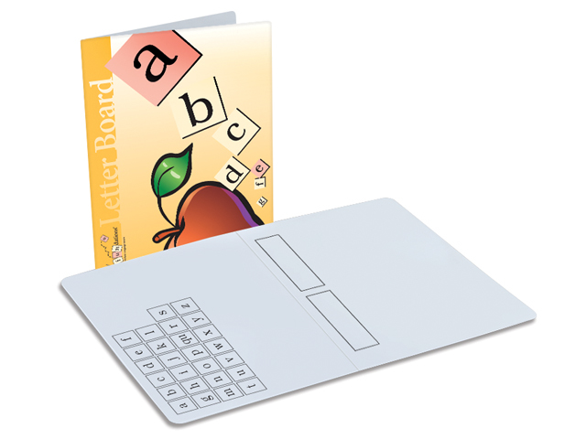
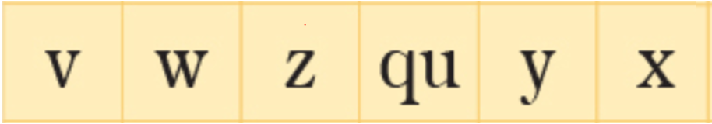

Magnet Letter Board

Slide 26
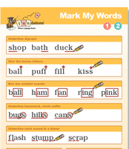



Dictation (Dry Erase)
Dictate:
3 current words
1 sentence
1 review word
2 trick words
1 sentence
s – p – e – l - l
Echo the word
Tap it out
Spell it out loud
Write it
Mark it
1
2
3

Slide 27
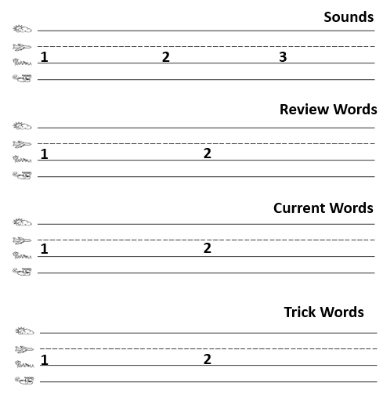
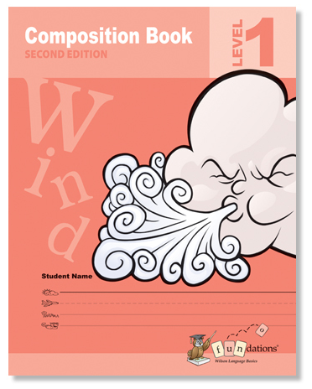

Dictation (Composition book)
Sounds
Dictate:
3 sounds
2 review words
2 current words
2 trick words.
(continued next slide)
Students repeat each dictation.
1
2
3
Review Words
1
2
Current Words
1
2
Trick Words
1
2

Slide 28

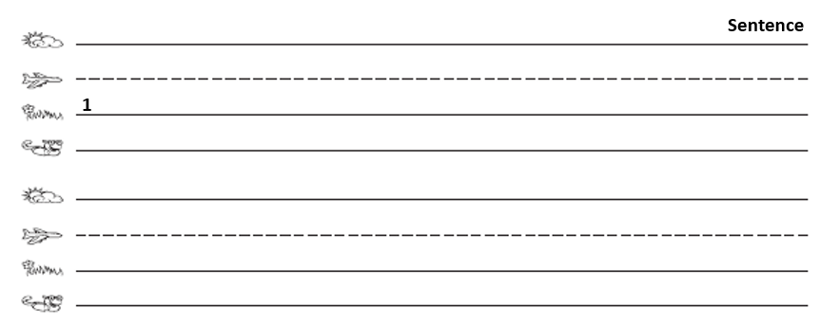
Dictation (Composition book)
Dictate 1 sentence.
Sentence
1

Slide 29



Thank you for your download!
@1stgrade.favoritethings

